Slide 1
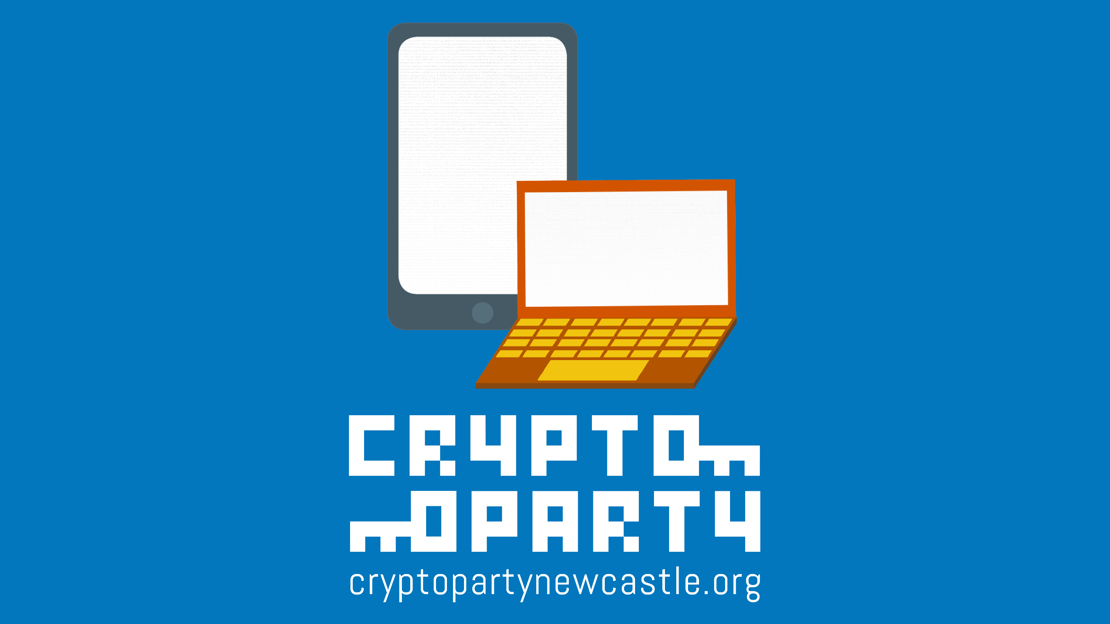

Slide 2
Topics
Tor Browser (and TAILS)
Signal Private Messenger
Full Disk Encryption
PGP
KeePass

Slide 3
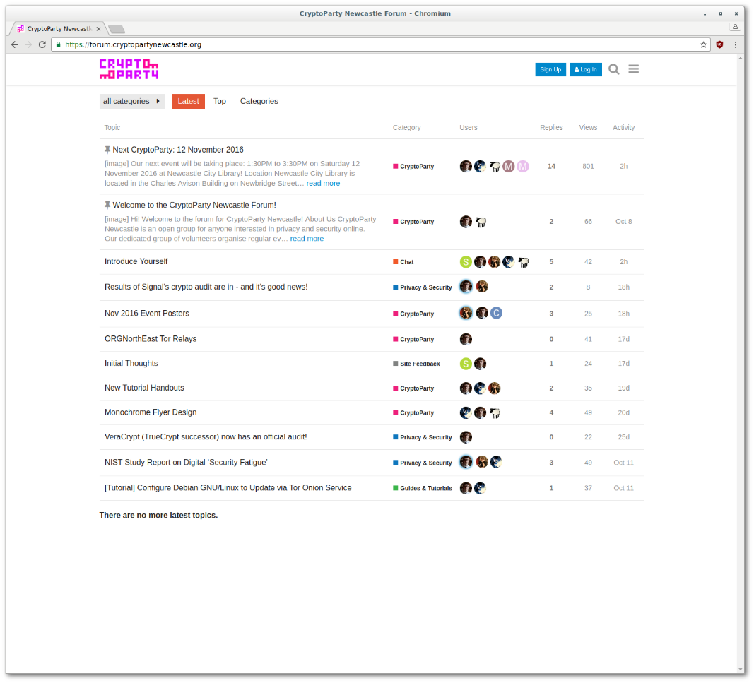
CryptoParty Newcastle Forum
cryptopartynewcastle.org

Slide 4
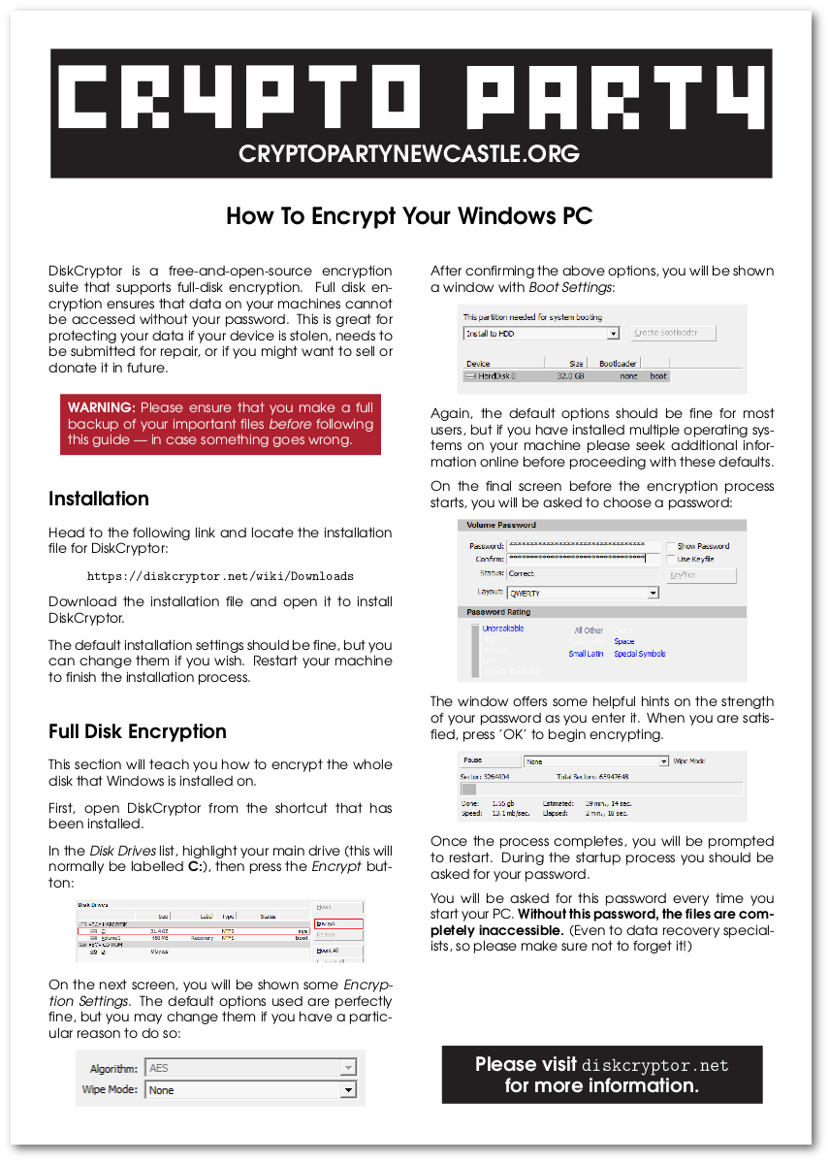
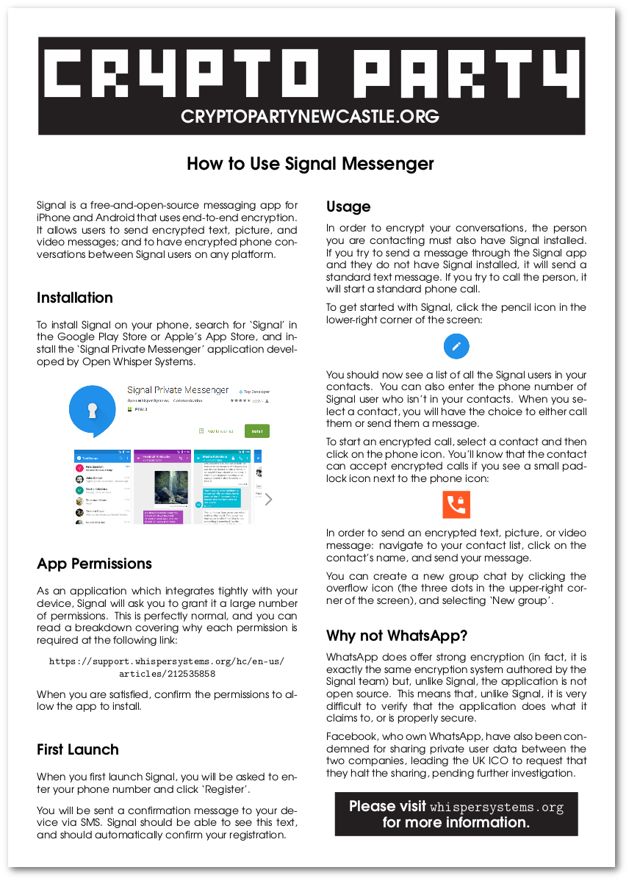
Handouts

Slide 5
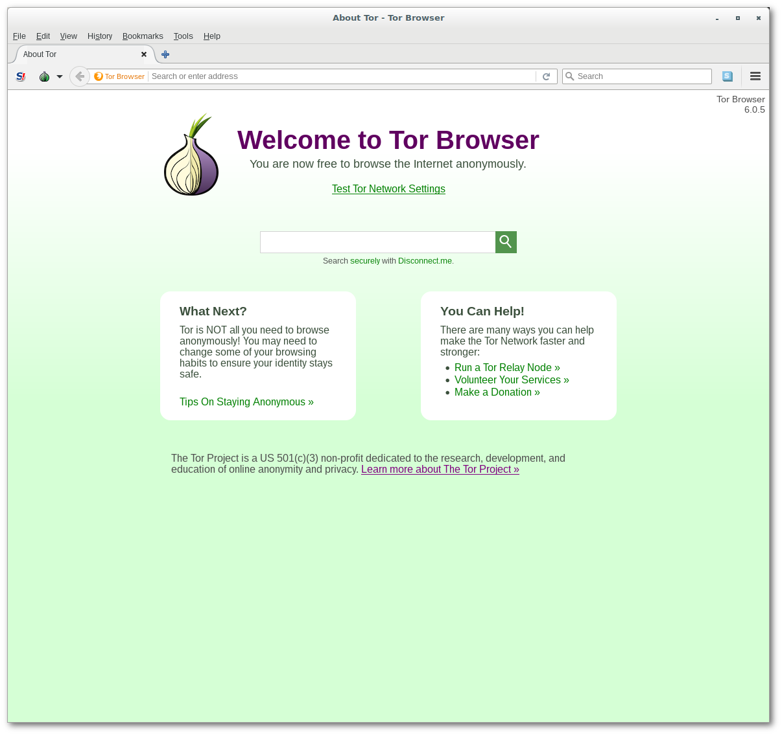
Tor Browser
A web browser that helps to defend your internet activity against surveillance.
Your connections are routed through multiple servers and countries before reaching their destination.
All connections are encrypted so that they cannot be read when in transit.
Maintain privacy, anonymity, and security.
Can be used instead of, or alongside, your current browser.

Slide 6
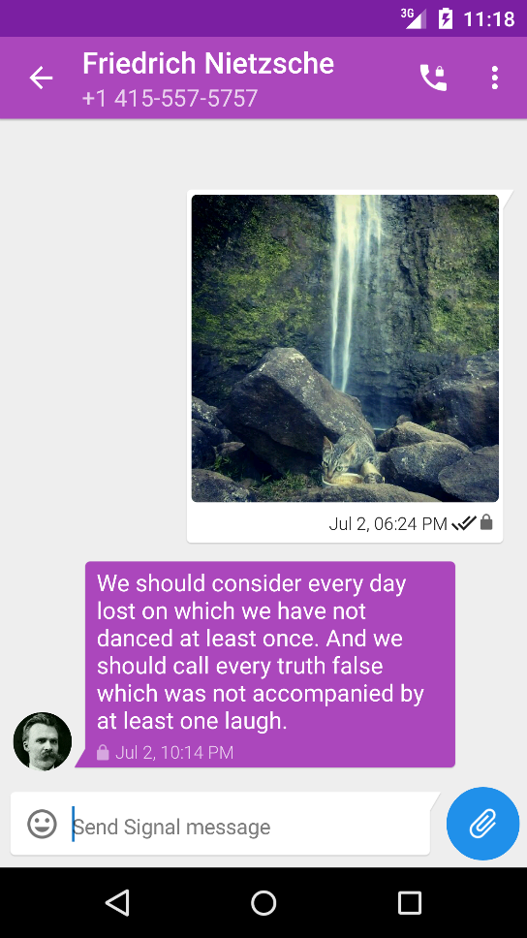
Signal Private Messenger
Secure, encrypted and simple instant messaging app for Android and iOS.
Supports text, picture and video messages as well as voice conversations.
Supports group messaging.
Can be used between Signal users on any supported platform.
Fully free and open source – unlike most other encrypted messaging apps!
Recently received a crypto & security audit.

Slide 7
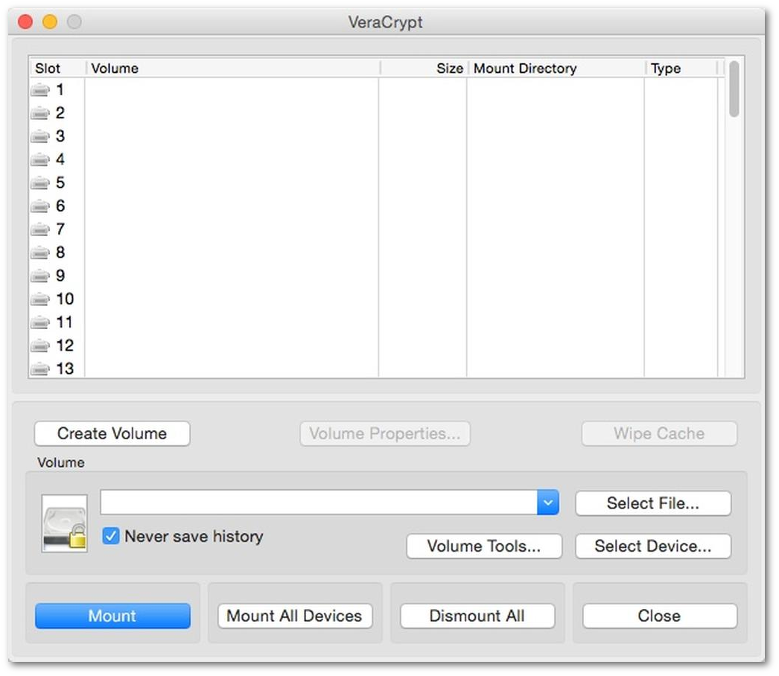
Full Disk Encryption
Most people store a lot of personal information on a PC/laptop.
Cache and temporary files tell a surprisingly detailed story about your life and everything you do on the machine.
Ensure that none of the data on your computer is readable without knowledge of your encryption password.
Nobody can read your data in the case of theft, or if you need to send away your machine for repair.

Slide 8
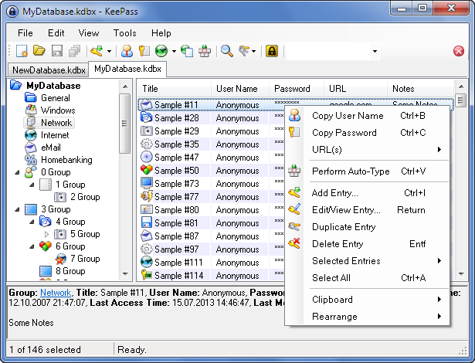
KeePass
A secure, encrypted password manager.
Free and open source software –supports Windows, macOS, and Linux.
Allows you to securely store all your passwords in an encrypted database.
Features an automatic password generator to generate long, random passwords for you.
‘Auto-Type’ feature will handle ‘typing’ in passwords to sites for you.
Don’t suffer like Yahoo! or LinkedIn users!

Slide 9
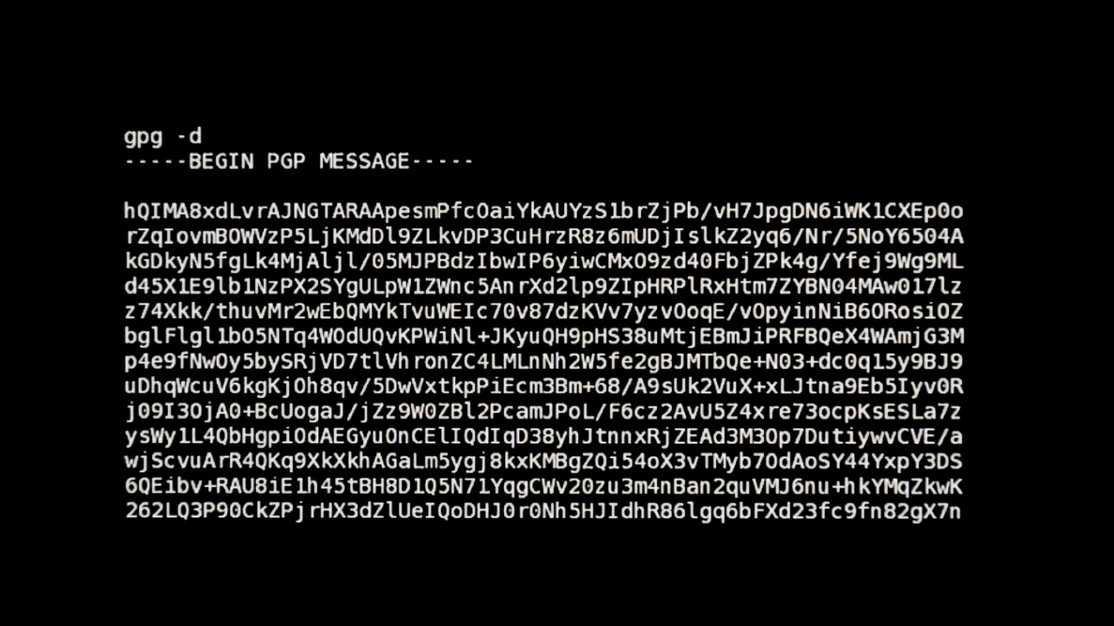
PGP
A method of encrypting email so that it cannot be read in transit.
Not quite as easy or flexible as something like Signal, but still gets a lot of use.
Requires both participants to have set up PGP and have public keys available.
Worthwhile setting up if email is your preferred method of communication.
Citizenfour (2014)

